Slide 1
Using conjunctions to express time, place or cause.

Slide 2
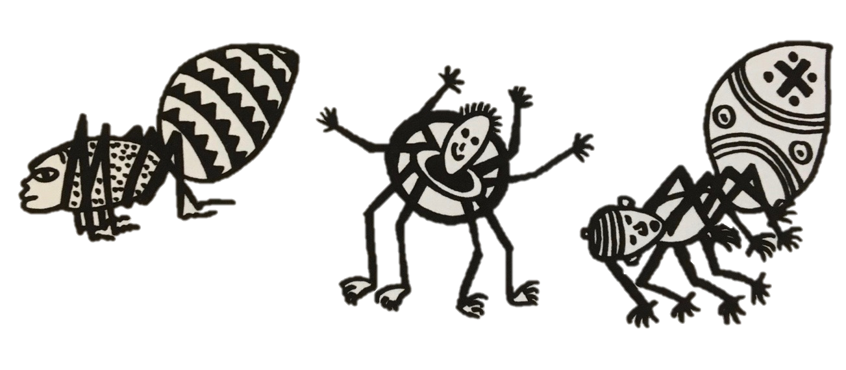
Verbs
A verb indicates what someone or something is doing, feeling or being.
He climbs.
The spider is crafty.
The villagers despair.
I saw him!
Revision

Slide 3
Verb Phrases
A verb phrase can be a single verb or a string of verbs.
The other animals think he is tricky.
He has had all sorts of adventures.
He has been causing problems for everyone.
Revision

Slide 4
Clauses
Clauses are groups of words with a verb phrase and a subject.
Ananse lives in a village.
He looks like a spider.
The other animals think he is tricky.
He has had all sorts of adventures.
Revision

Slide 5
Conjunctions
Conjunctions are words that join clauses into sentences.
CLAUSE
CONJUNCTION
CLAUSE
He is extremely unusual because he is a spider man.
Revision

Slide 6
Conjunctions
Conjunctions are words that join clauses into sentences.
Cause
Time
Place
because
after
where
before
wherever
as
when
so
since
since
until
as
while

Slide 7
End

