Slide 1
Adverbials

Slide 2
Verbs
Verbs indicate that someone or something is
doing, feeling or being.
The tide creeps up the sand.
The shadows cross the land.
The dew dries on the dock.
The green moss spreads!
Usually verbs have the name of a person or thing or a pronoun in front of them.
Revision

Slide 3
Adverbials
Adverbials tell us more about a verb.
Adverbials can be
a word,
a phrase,
or a clause.
slowly
at a snail’s pace
while the whole world slept

Slide 4
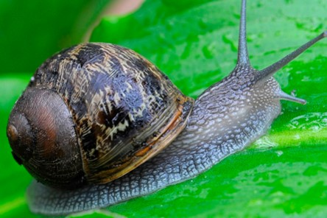
Adverbials
Adverbials tell us more about a verb.
The snail slid.
The snail slid with no hurry.
The snail slid across the leaf.
The snail slid silently.
In each sentence, the verb is modified by the adverbial.

Slide 5
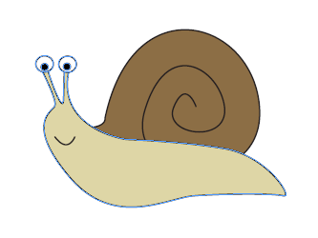
Adverbials
Adverbials can be in different places in a sentence.
The snail slid.
The snail slid with no hurry.
The snail slid across the leaf.
The snail slid silently.
The snail slid.
With no hurry, the snail slid.
Across the leaf, the snail slid.
Silently, the snail slid.
When it is at the start of a sentence, the adverbial is called a fronted adverbial.

Slide 6
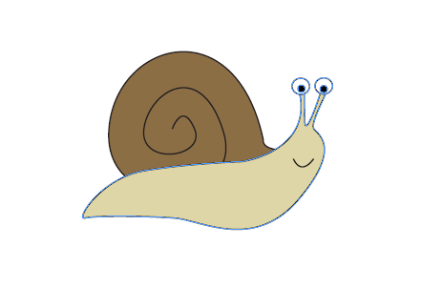
Punctuating Fronted Adverbials
Fronted adverbials are separated from the main part of the sentence by a comma.
With steady determination, the snail slid.
Try saying the whole sentence with and without a pause.
The comma tells the listener that the main information is coming.
This is great for building tension.

Slide 7
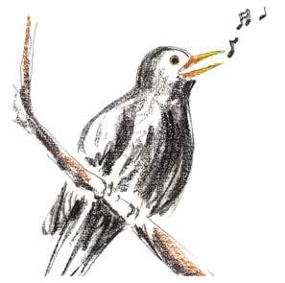
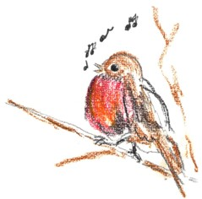
Punctuating Fronted Adverbials
Spot the fronted adverbial in each sentence.
Decide where the comma should go.
In the brown water, a fish lay quietly dozing.
High in the blue above, birds were singing.
At the edge of the tide, the waves broke.
Whenever the moon and stars are set, the badgers venture out.
Whenever the wind is high, the leaves rattle and fall.
In the brown water a fish lay quietly dozing.
High in the blue above birds were singing.
At the edge of the tide the waves broke.
Whenever the moon and stars are set the badgers venture out.
Whenever the wind is high the leaves rattle and fall.

Slide 8
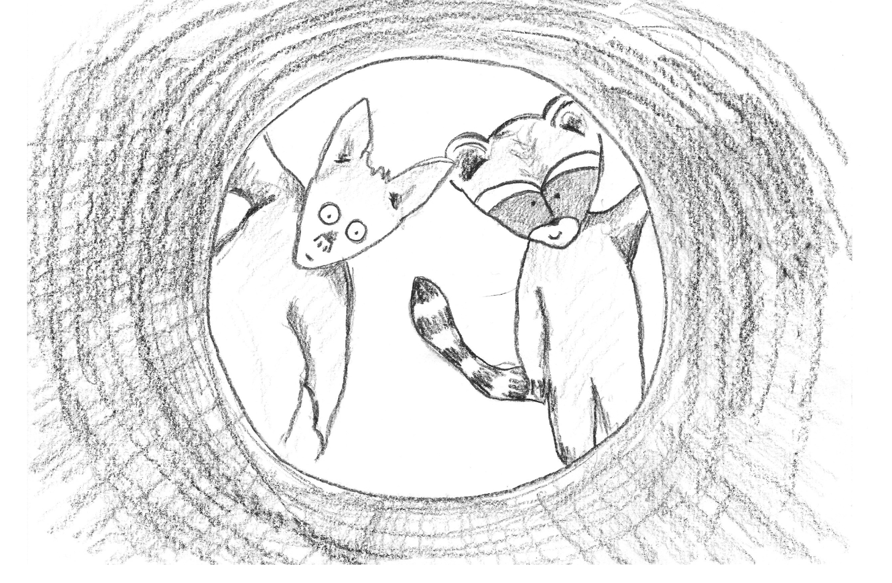
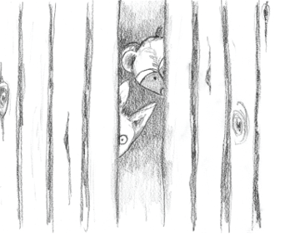
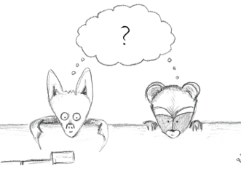
Adverbials
Adverbials answer the questions…
Where?
When?
How?

Slide 9
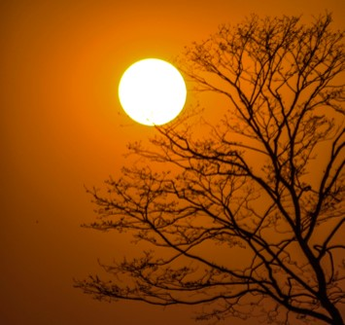
Adverbials
Where?
The sun sheds its light.
From high in the sky, the sun sheds its light.
Over the cold earth, the sun sheds its light.
Into the darkness, the sun sheds its light.
Adverbials can answer the question: Where?

Slide 10
Adverbials
When?
The sun shed its light.
When the world was cold, the sun shed its light.
Before the snow melted, the sun shed its light.
Right at that moment, the sun shed its light.
Adverbials can answer the question: When?

Slide 11
Adverbials
How?
The sun shed its light.
Brightly, the sun shed its light.
With warmth and colour, the sun shed its light.
Like an old friend returning, the sun shed its light.
Adverbials can answer the question: How?

Slide 12
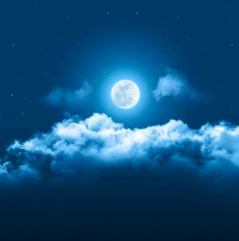
Adverbials
Adverbials often open with a preposition.
With a ghostly appearance, the moon rose.
Through the cold air, the moon rose.
In the winter sky, the moon rose.
Thinking of a preposition can help you to think of an adverbial.

Slide 13
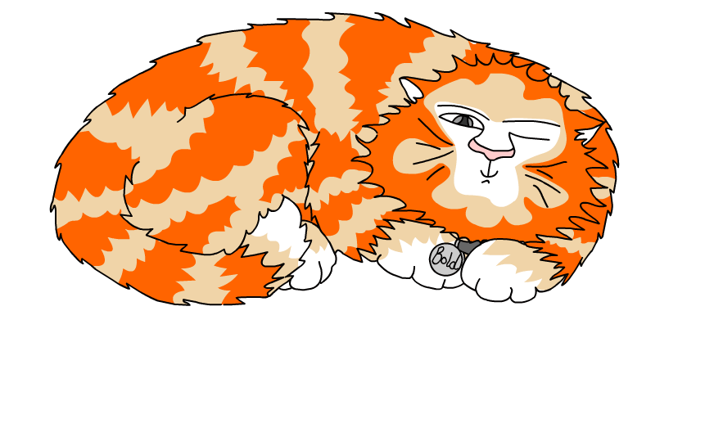
Explore more Hamilton Trust Learning Materials at https://wrht.org.uk/hamilton/ .

